Slide 1
Central Banking
System
Presented by: Group 4
Md Fuad Anan (251014032)
Tapu Shikari (222014064 )
Sithi Saha (242014064 )
Jannatul Ferdous Lamia (242014001)
Maha Islam (252014045 )
Presented to:
Md Al Amin Sheikh, Ph.D.
Assistant Professor, Department of CSE
University of Liberal Arts Bangladesh
Report date: 19 August 2026
$

Slide 2

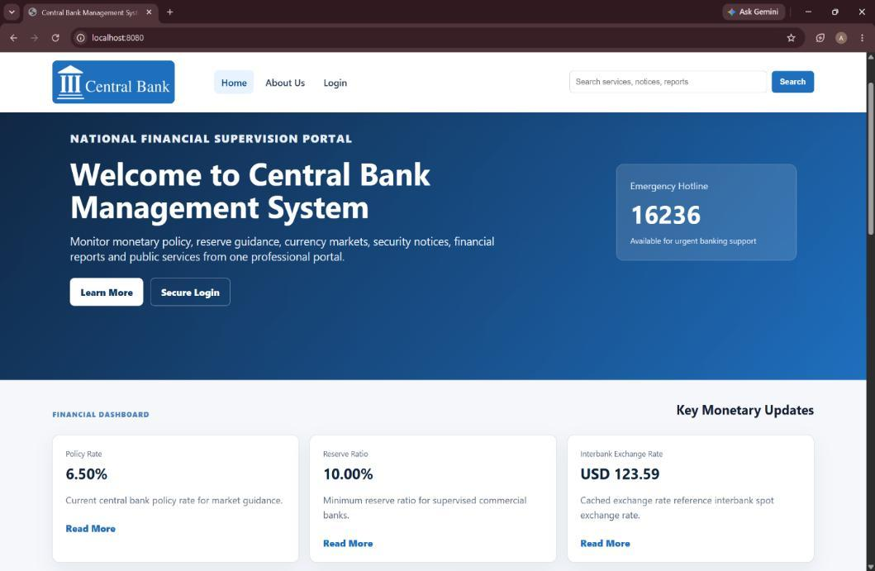
The project solves a monitoring problem
Central-bank supervision becomes difficult when information is scattered:
- Multiple commercial banks must be monitored together
- Loans, reserves, transactions, and approvals need clear records
- Suspicious activity is hard to identify manually
- Reports and decisions need reliable, centralized data
Notes:
Timing: 0:50-1:50
Script:
A central bank supervises many activities at the same time. Commercial banks have reserves, loans, customer accounts, transactions, and approval requests, and those records need to be controlled together. When information is handled separately, it becomes harder to monitor risk, identify suspicious transfers, and make timely decisions. Version 9.00 addresses that problem with a centralized simulator. It is not a real national banking platform; it is a controlled learning environment that demonstrates central-bank supervision through one role-based web interface.
[Sources]
- Final_designReport.pdf, pages 2, 4, 6-7
- Version 9.00 source: CentralBankSystem.java

Slide 3
The objective is controlled central-bank supervision
01
Register and manage commercial banks under one central system.
02
Support money supply, liquidity, reserve, and monetary policy operations.
03
Monitor inter-bank transactions and flag suspicious activity.
04
Manage customers, accounts, loans, approvals, and notifications.
05
Generate reports for banks, reserves, fraud, loans, performance, and risk.
Notes:
Timing: 1:50-2:50
Script:
The project objective is to design and develop a simulator for managing and monitoring banking operations. The implemented scope is to register and supervise commercial banks, support money-supply and liquidity operations, monitor inter-bank transactions, manage reserves, provide role-based web access, and generate reports about banks and investment risk. The project focuses on the regulatory view: a central authority supervises banks, evaluates risk, approves controlled changes, and keeps records organized.
[Sources]
- Final_designReport.pdf, pages 4, 7-8
- Version 9.00 source: CentralBankSystem.java

Slide 4
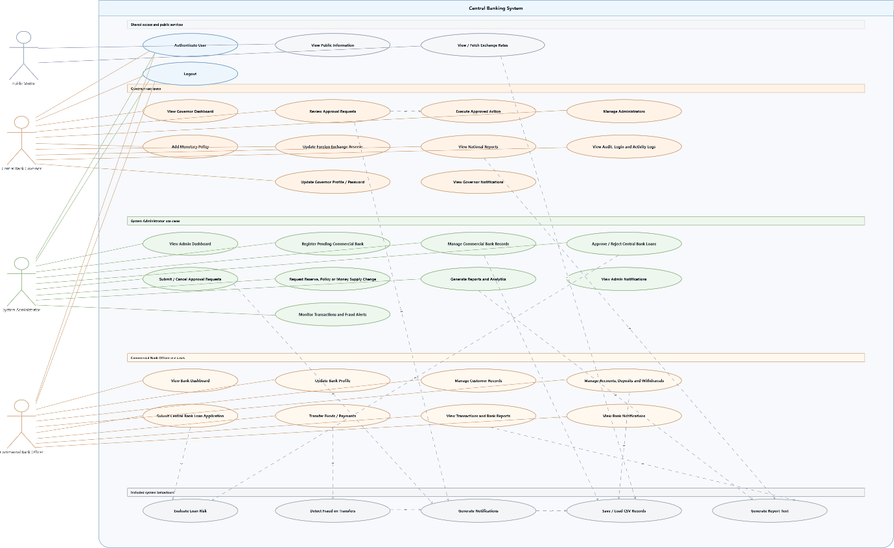
Three user roles keep authority separated
Governor
Highest authority
Manages administrator access
Approves or rejects critical requests
Administrator
Submits bank applications
Decides loans
Requests policy, reserve, and supply changes
Commercial Bank
Uses bank dashboard
Applies for loans and transfers
Manages customers, accounts, and profile
.
Use-case view from the final report
Notes:
Timing: 2:50-3:50
Script:
Version 9.00 uses three roles: Governor, Administrator, and Commercial Bank. The Governor has the highest authority. The Governor manages administrator accounts and reviews or rejects critical approval requests. The Administrator submits commercial-bank applications and requests for money supply, reserves, and policy changes; the Administrator also decides pending loans. A Commercial Bank applies for loans, transfers funds, updates its profile, and manages its customers and accounts. This exact separation prevents a request from being applied without the Governor's approval where Version 9 requires it.
[Sources]
- Final_designReport.pdf, pages 2, 7, 15, 21-22
- Version 9.00 source: UserRole.java, AppRouter.java, CentralBankSystem.java

Slide 5
The feature set covers the main banking workflow
Management | Financial Operations | Monitoring and Output
Bank registration and suspension | Inter-bank fund transfers | Risk assessment
Customer and account handling | Loan applications and decisions | Fraud detection
Role-based dashboards | Deposits and withdrawals | Approval requests
Administrator and Governor control | Reserve management | Notifications
Commercial bank profile control | Monetary policy updates | Audit and activity logs
Data stored in structured CSV files | Exchange-rate information | Bank, loan, reserve, fraud, and summary reports
Notes:
Timing: 3:50-5:00
Script:
The implementation covers the main banking workflow. Bank management supports bank applications, editing, suspension and closure requests, and Governor approval. Customer and account functions create and update customers, record deposits, and record withdrawals. Commercial Banks apply for loans; an Administrator decides the loan and, if approved, the system disburses it. The system also records inter-bank transfers, reserve management, money-supply operations, monetary policies, notifications, logs, exchange-rate information, and structured reports. These modules connect day-to-day activity with central supervision.
[Sources]
- Final_designReport.pdf, pages 7-8, 12, 28
- Version 9.00 source: CentralBankSystem.java, ReportService.java

Slide 6
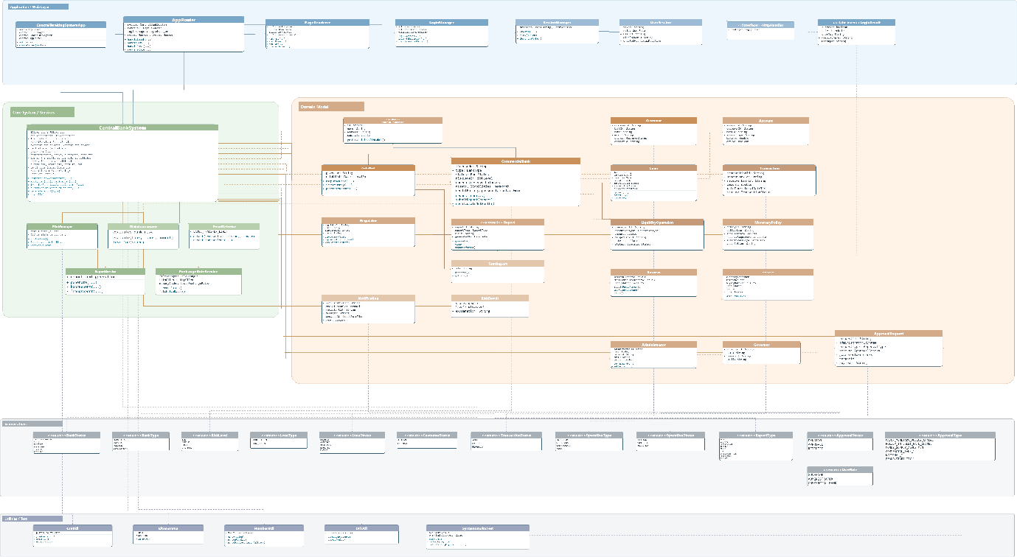
Architecture and data flow
Browser UI
PageRenderer
HTML and CSS pages rendered from Java
v
AppRouter
Routes GET/POST requests to the correct operation
v
Services
CentralBankSystem, LoginManager, RiskAssessment, FraudDetector
v
Models
Bank, Customer, Account, Loan, Transaction, Reserve, Policy
v
CSV Storage
Banks, customers, accounts, loans, transactions, reserves, logs
Notes:
Timing: 5:00-6:10
Script:
Technically, Version 9.00 is built with Java, HTML, and CSS. CentralBankingSystemApp creates Java's built-in HTTP server, and AppRouter directs GET and POST requests to the appropriate operation. PageRenderer produces the HTML and CSS pages. CentralBankSystem coordinates the banking rules, while LoginManager, RiskAssessment, FraudDetector, ReportService, and FileManager support focused responsibilities. The model classes represent banks, customers, accounts, loans, transactions, reserves, policies, and approvals. CSV files store the project data, rather than a relational database.
[Sources]
- Final_designReport.pdf, pages 2, 9, 11-12, 18
- Version 9.00 source: CentralBankingSystemApp.java, AppRouter.java, PageRenderer.java, FileManager.java

Slide 7
Risk and approval controls
Risk assessment
Fraud detection
- Reserve position
- Debt ratio
- Credit rating
- Previous loan history
- Requested amount vs. capital
- Outstanding loan exposure
- Zero or negative transfer amount
- Transfer of 500,000 or more
- Negative sender balance
- Repeated failed transfers
- Repeated 100,000+ transfers
between same banks (24h)
Output: score + LOW / MEDIUM / HIGH / CRITICAL level
Output: warnings, FLAGGED status, alerts, and audit log
Notes:
Timing: 6:10-7:25
Script:
Version 9.00 uses rule-based controls. RiskAssessment calculates a score from reserve ratio, debt ratio, credit rating, previous loan count, requested amount compared with capital, and outstanding loan exposure. It returns LOW, MEDIUM, HIGH, or CRITICAL risk. FraudDetector creates warnings for non-positive amounts, transfers of 500,000 or more, negative sender balance, repeated failed transfers, and repeated transfers of at least 100,000 to the same receiver within one day. When warnings exist, the transfer is flagged, an alert is kept, and the transaction is audited. Approval requests then give the Governor control over the critical administrative changes.
[Sources]
- Final_designReport.pdf, pages 5, 8, 12, 28-29
- Version 9.00 source: src/main/java/central_banking_system/RiskAssessment.java
- Version 9.00 source: src/main/java/central_banking_system/FraudDetector.java
- Version 9.00 source: CentralBankSystem.java

Slide 8
Development followed an iterative path
Weeks 1-4
Weeks 5-7
Weeks 8-10
Weeks 11-13
Week 14
Topic, proposal,
requirements
Background study,
UML, web learning
Login, backend,
exchange rates
Governor role,
debugging, UML update
Final report and
presentation
Notes:
Timing: 7:25-8:15
Script:
The report describes an iterative development approach. The team first selected the topic, wrote the proposal, analyzed requirements, completed background study and UML design, and learned the web application structure. The implementation then progressed through the homepage, role-based login, backend functions, CSV data handling, exchange-rate integration, the Governor role, integration and debugging, UML updates, and final documentation. Building module by module made it easier to test each part before integrating it with the wider system.
[Sources]
- Final_designReport.pdf, pages 18-23

Slide 9
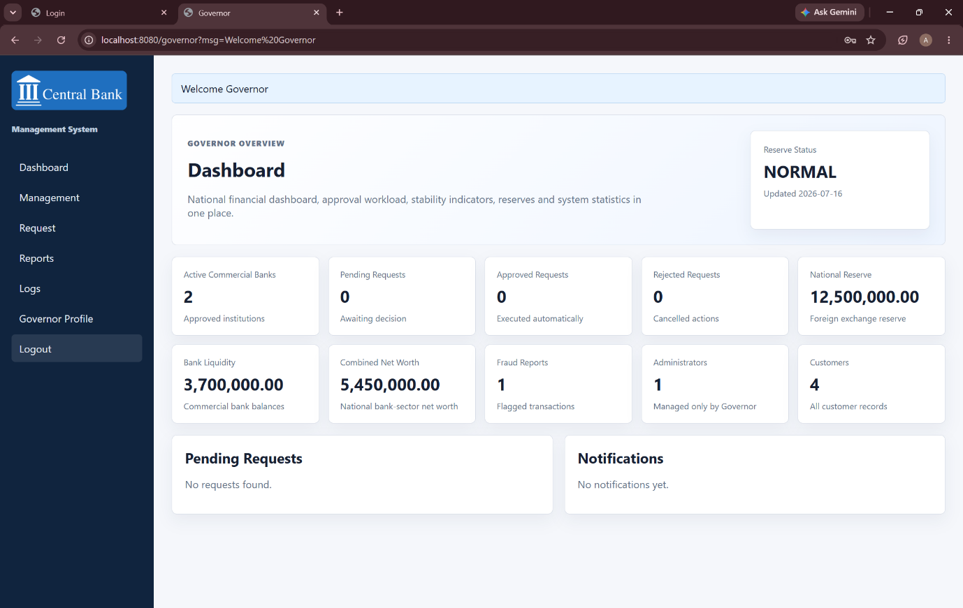
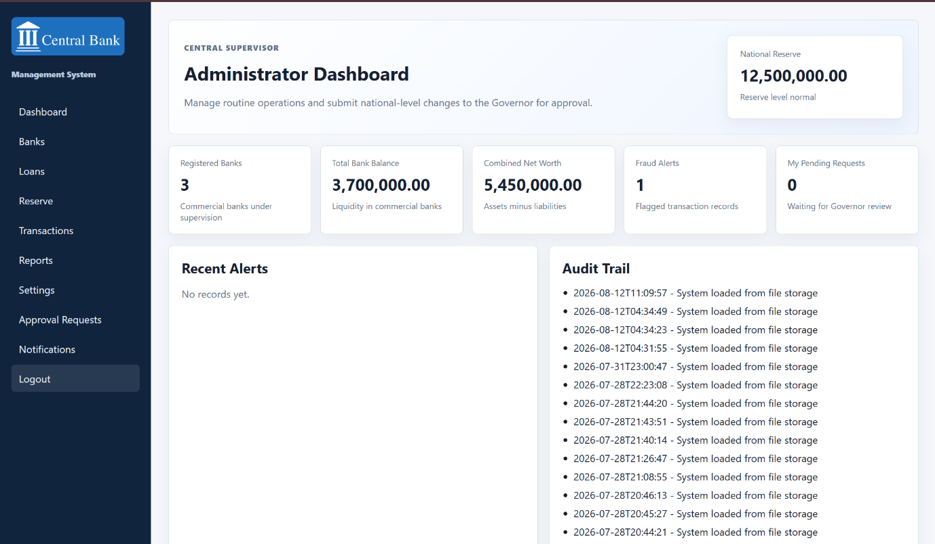
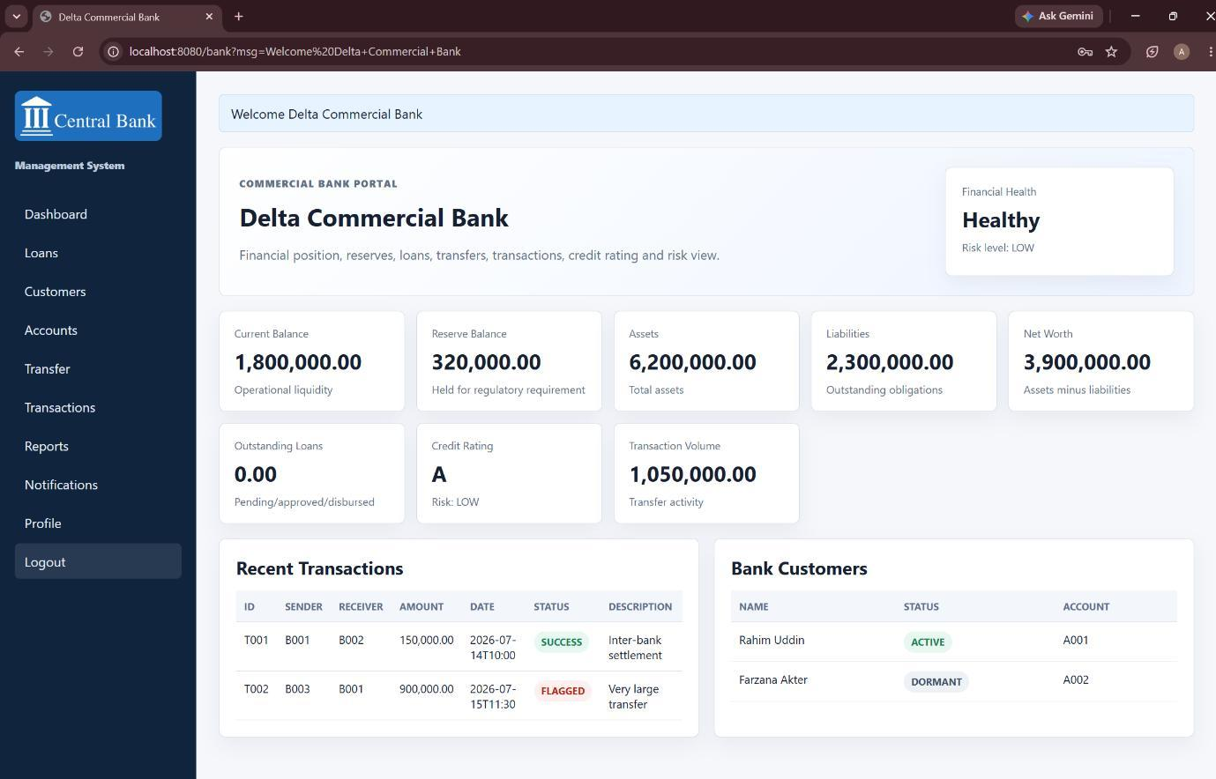
The implemented interface proves the workflow
Public home
Governor dashboard
Administrator dashboard
Commercial bank dashboard
Notes:
Timing: 8:15-9:15
Script:
These are interfaces from the completed project. The public home page introduces the system. The Governor, Administrator, and Commercial Bank dashboards each show only the role-specific functions. The source also includes a smoke test that verifies the public page, the three logins, role restrictions, administrator bank applications, Governor review, and the newly approved bank login. In a live demonstration, we would show login, navigation, a bank application, approval review, a loan or transfer, and reporting.
[Sources]
- Final_designReport.pdf, pages 23-27
- Version 9.00 source: PageRenderer.java, SystemSmokeTest.java

Slide 10
Conclusion
The simulator is a foundation
for a stronger system
Limitation:
Simulation only; not a real central banking system
Simplified financial, risk, and fraud processes
Uses CSV files instead of a scalable database
Limited data handling and scalability
Basic fraud detection and risk analysis
Weak security and lack of full compliance
Not suitable for high transaction volume or real-time monitoring
Future improvements:
Relational database integration
MFA, encryption, and security auditing
Interactive analytical dashboards
Machine-learning fraud detection
Larger-data performance testing
0
Notes:
Timing: 9:15-10:00
Script:
To conclude, Version 9.00 delivers role-based supervision, bank and customer-account operations, loans, transfers, reserves, monetary policy, approval requests, notifications, reports, risk scoring, fraud warnings, and activity logs. It remains a simulator: it uses local CSV storage, simplified risk and fraud rules, and basic local session handling. The report proposes a relational database, stronger security such as multi-factor authentication and encryption, interactive analytical dashboards, machine-learning fraud detection, richer risk analysis, and performance testing with larger datasets. Thank you. We are ready for questions.
[Sources]
- Final_designReport.pdf, pages 28-29
- Version 9.00 source: CentralBankSystem.java

Slide 11
Thank You!
&
Any questions?
$
€
£

